Slide 1
Mental Wellness Sentiment Analysis
Description of the problem
Provide a starting point for therapists with new clients
Automatically estimate person’s mental wellness based on a text sample
Improve the process of performing qualitative analysis
Approach
Scrape labeled data from webpages
Organize the data, then split the data into training set and validation sets
Feed the training data set into a RNN (Recurrent Neural Network) LSTM model, use validation data set to validate the accuracy of the trained model.
Tuning the hyperparameters to improve validation accuracy, such as number of layers, regularization via dropout
Participant: Jiaan Nie, 200327281

Slide 2
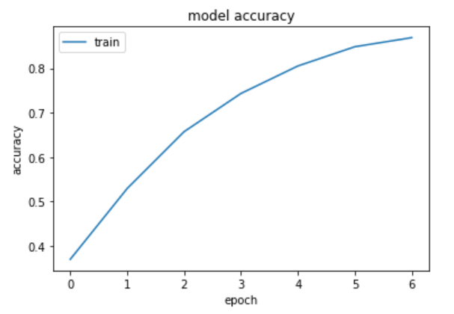
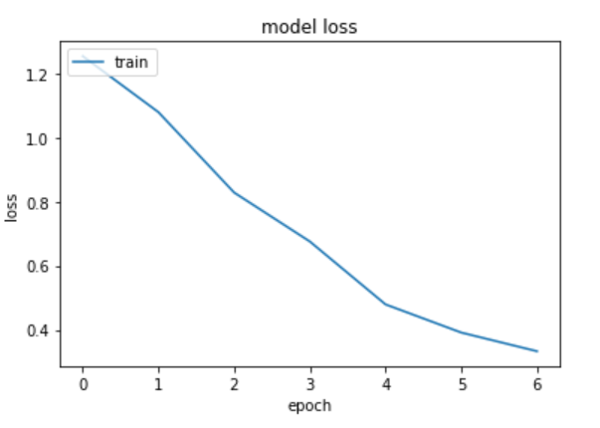
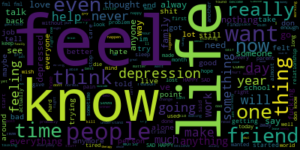
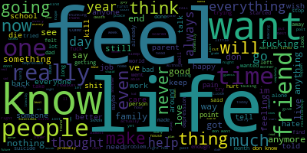

Result

